Slide 1
Now I am going to show you
A Project on Hotel Booking management System
In this project I have tried to focus only on JSP and JSF
Mechanism. Here you will be able to find how to transfer
Data to another pages through JSP and JSF. To make this project I have used net Bean IDEA.

Slide 2
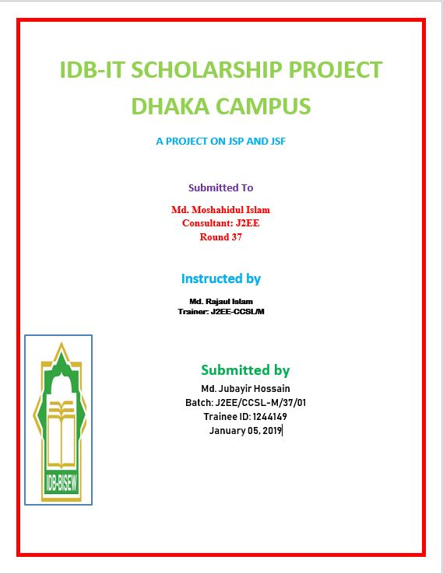

Slide 3
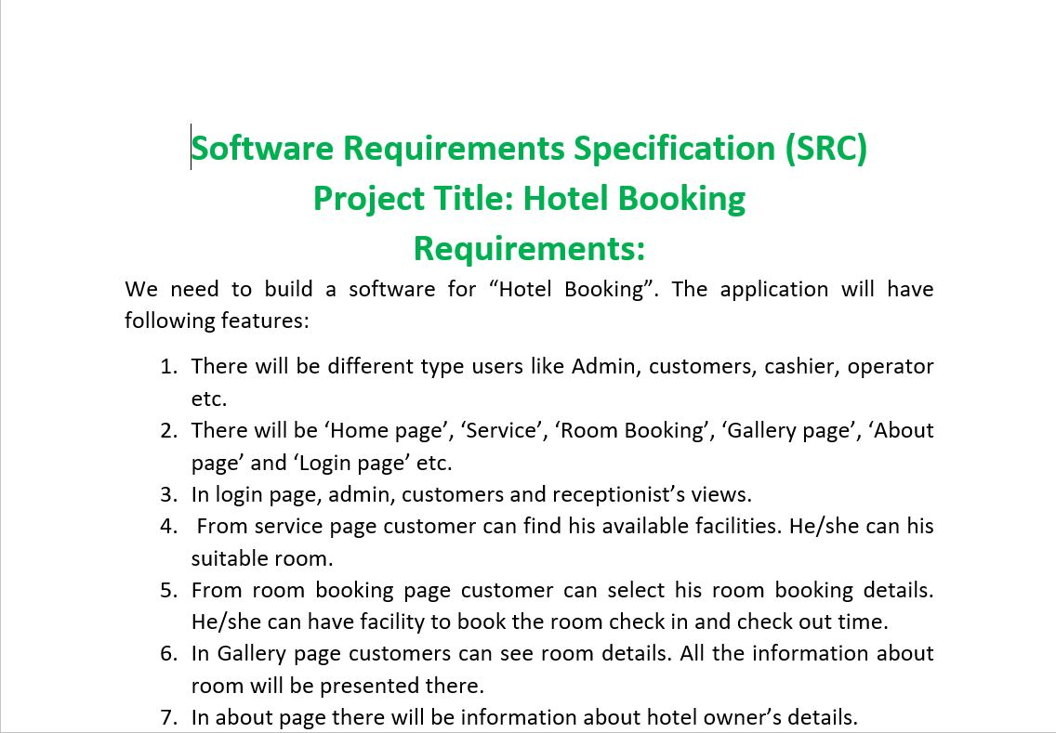
SRC INFORMATION

Slide 4
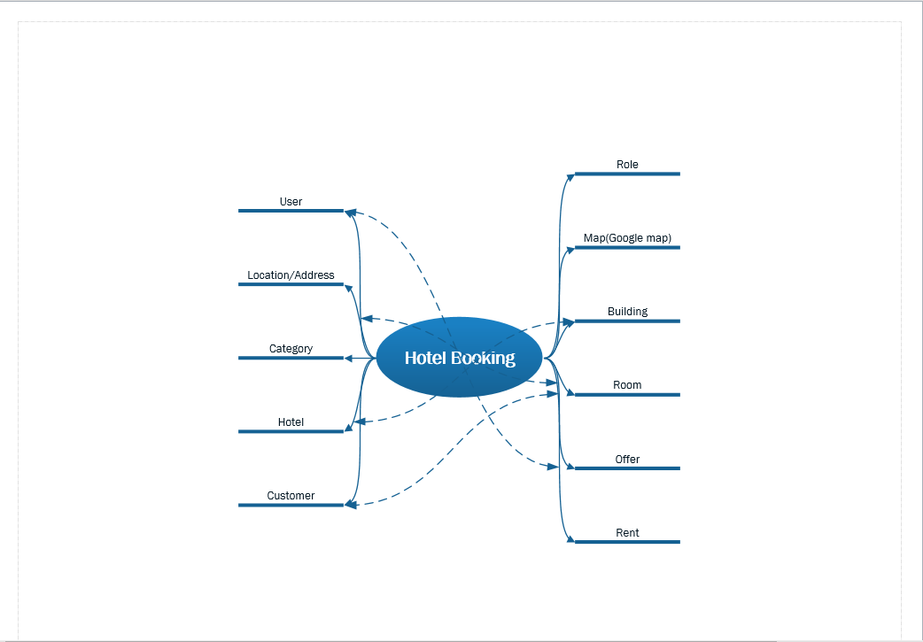
UML BRAINSTORM SHAPE

Slide 5
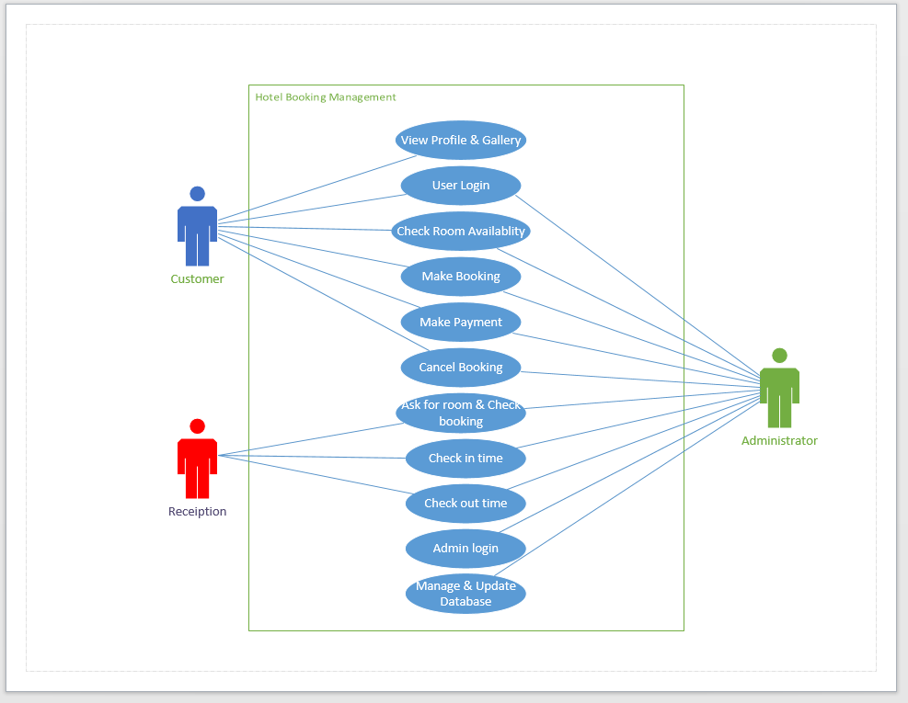
UML USE CASE DIAGRAM

Slide 6
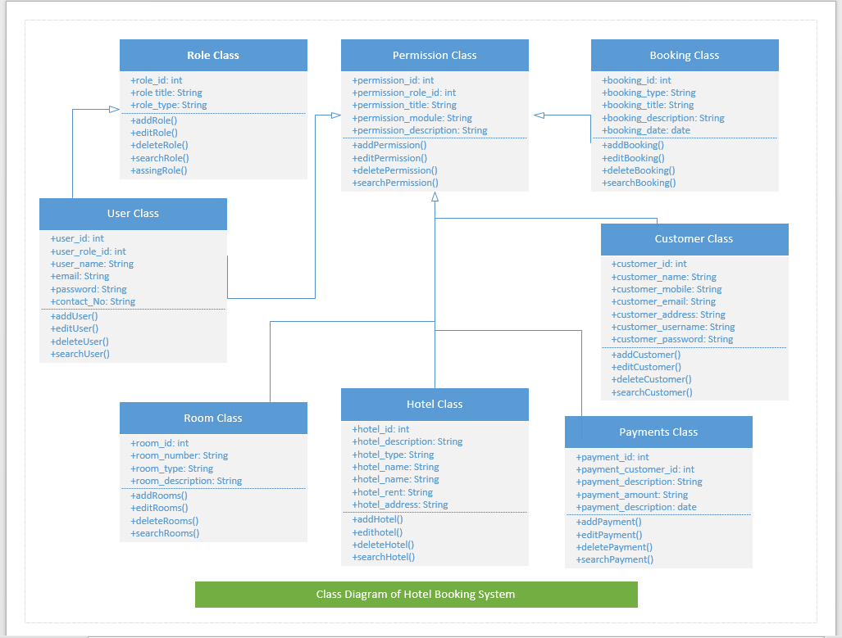
UML CLASS DIAGRAM

Slide 7
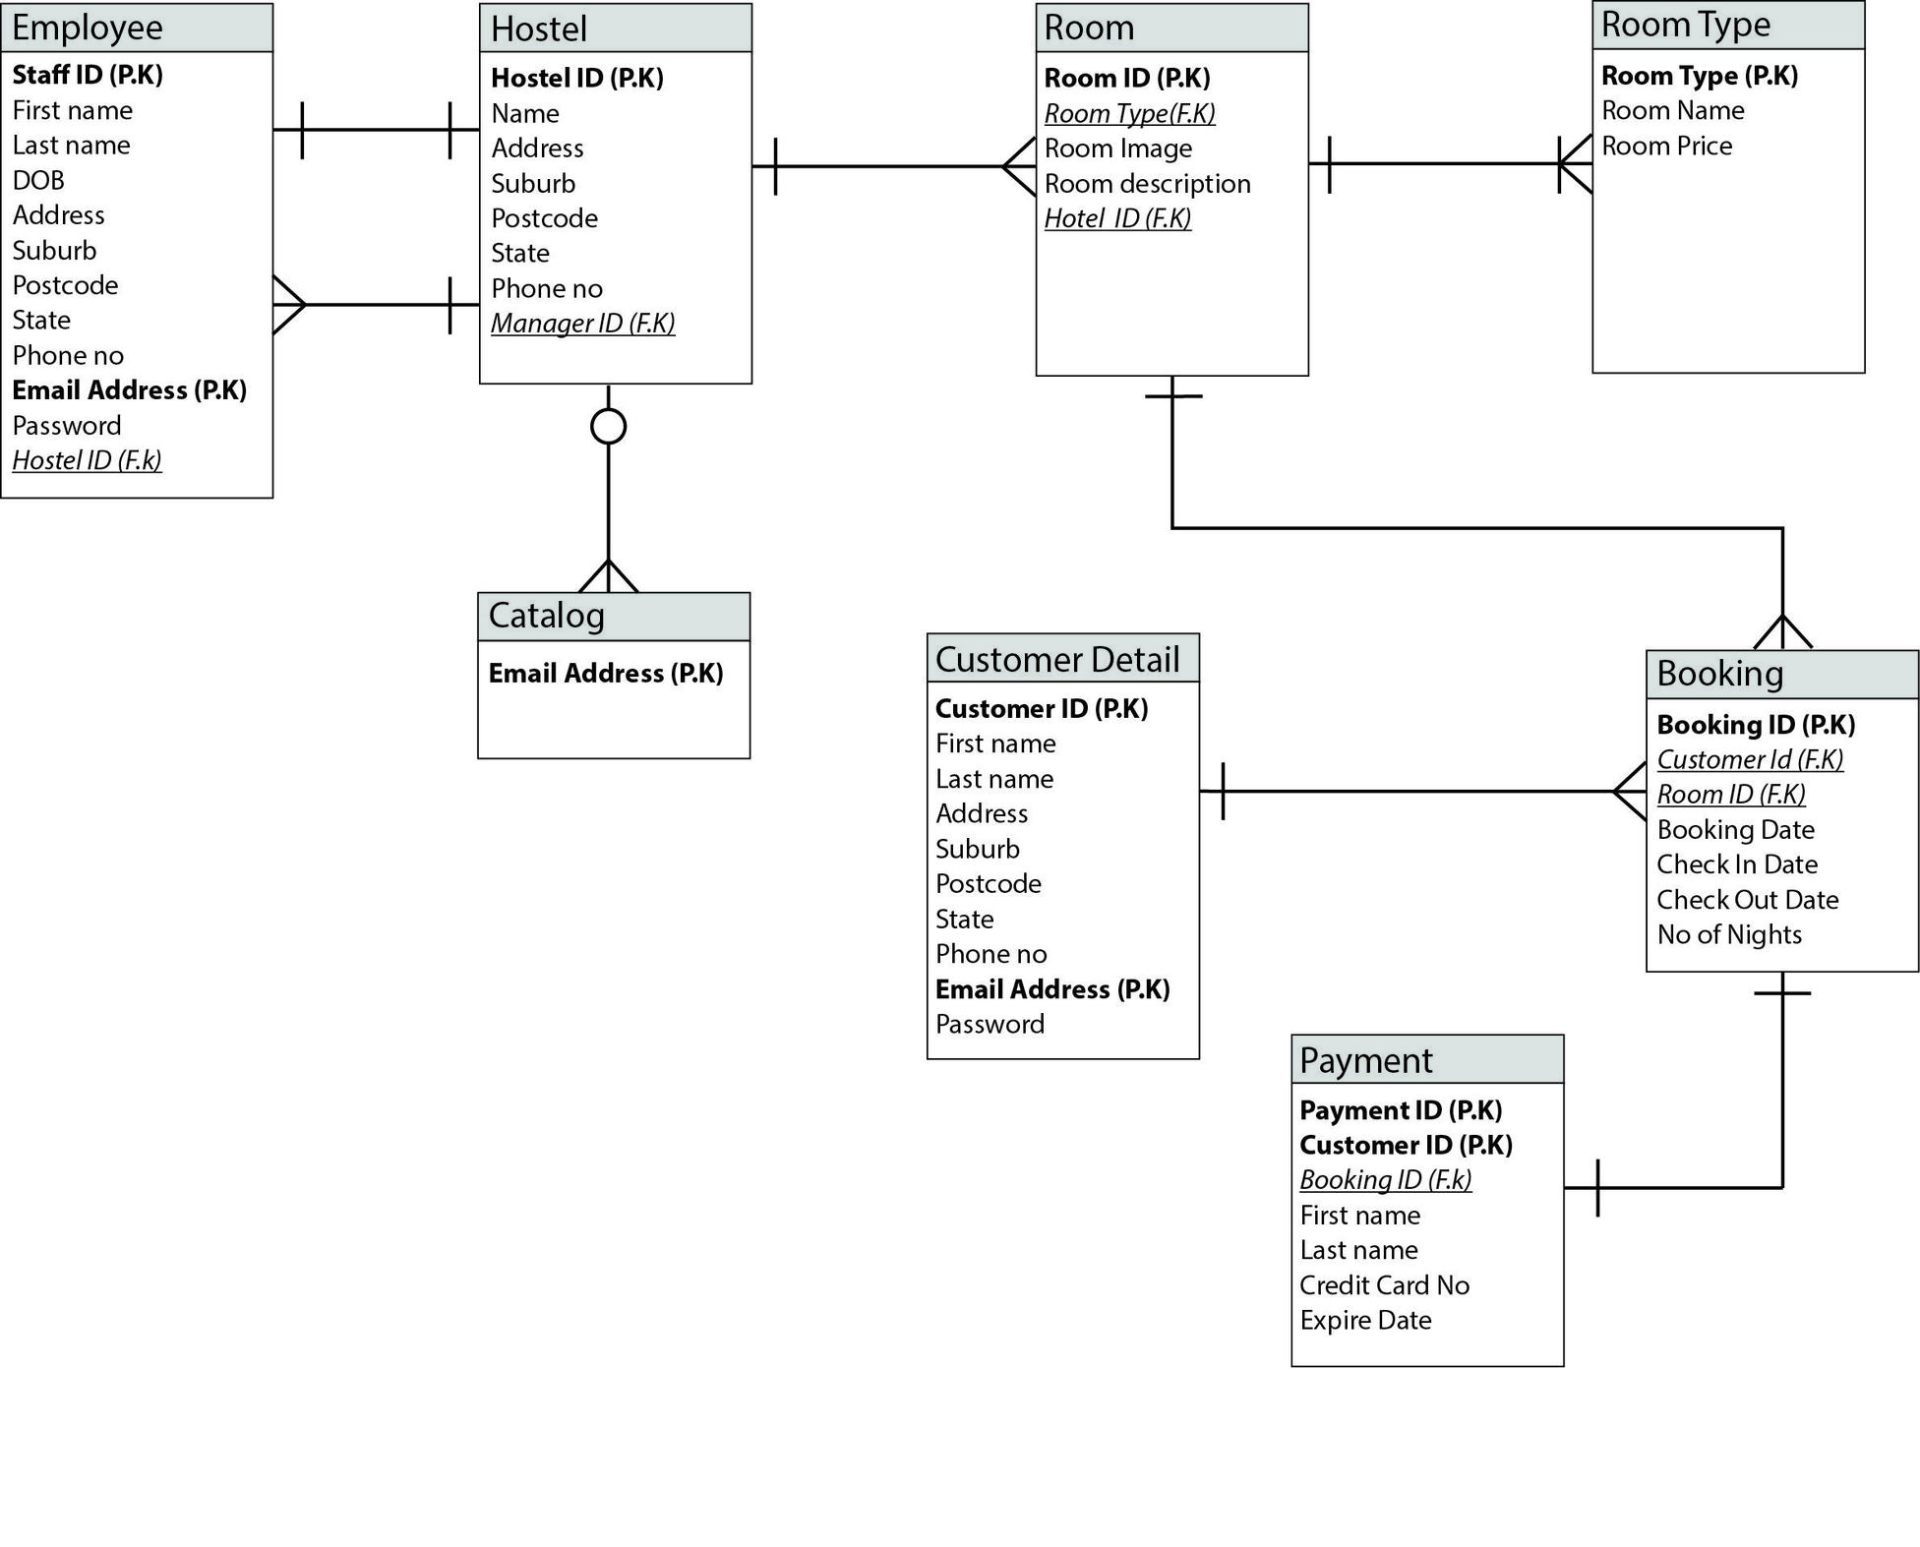
ENTITY RELATIONSHIP

Slide 8
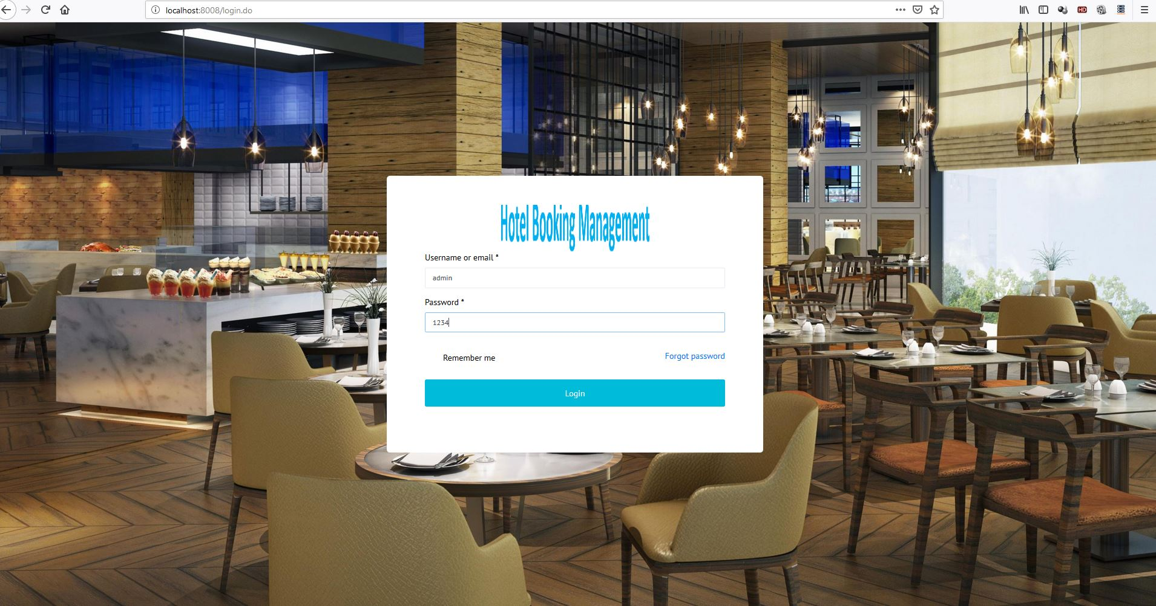
Login View

Slide 9
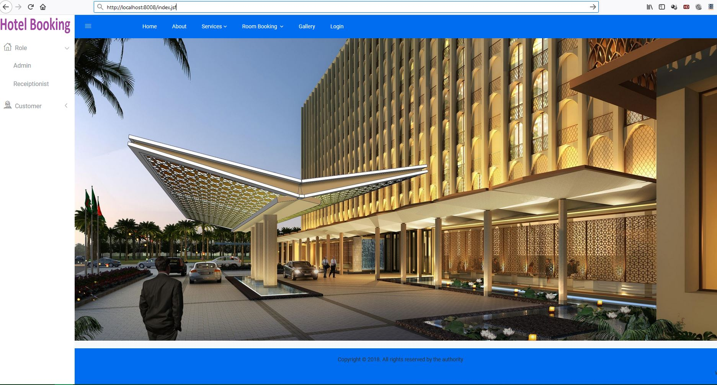
INDEX VIEW

Slide 10
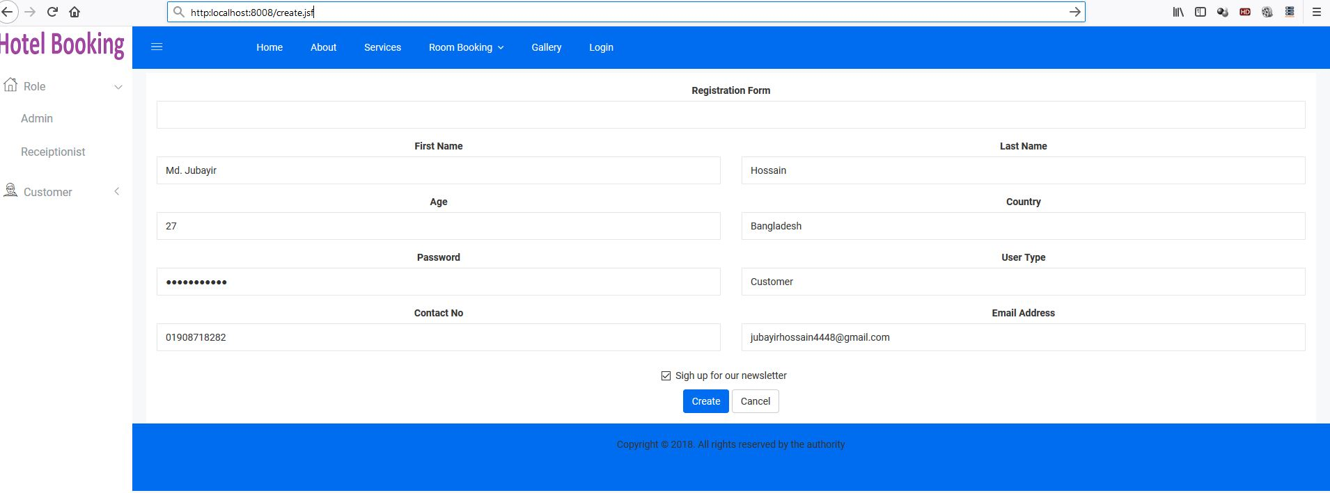
REGISTRATION FORM

Slide 11
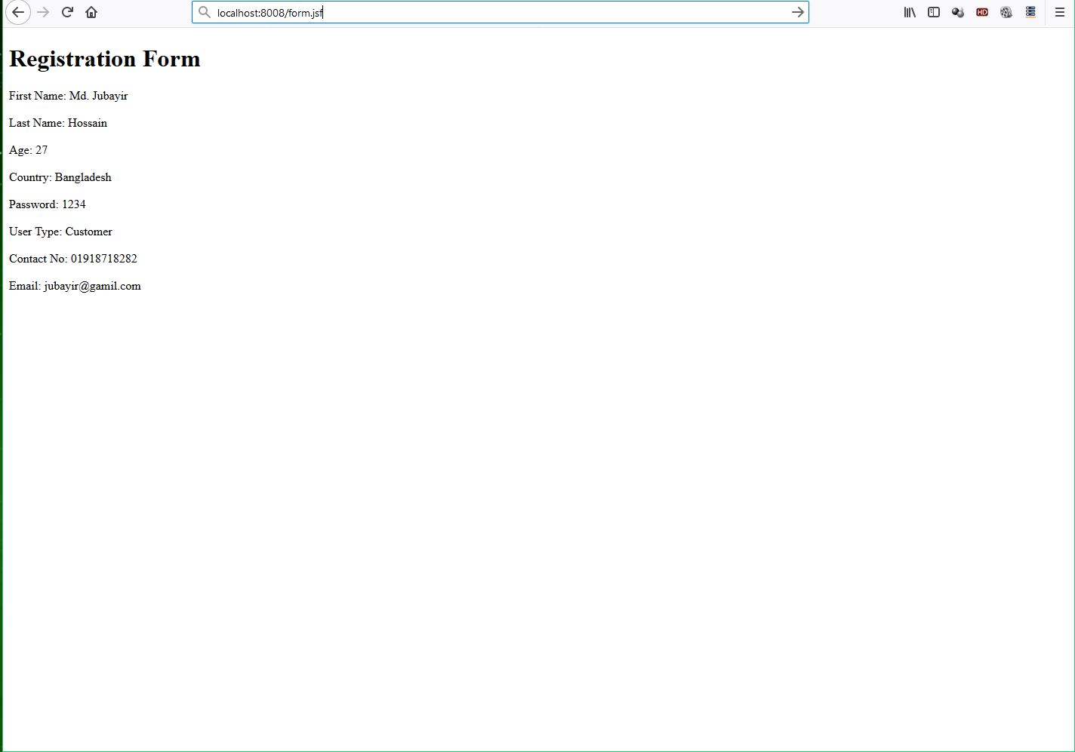
USER INPUT VIEW

Slide 12
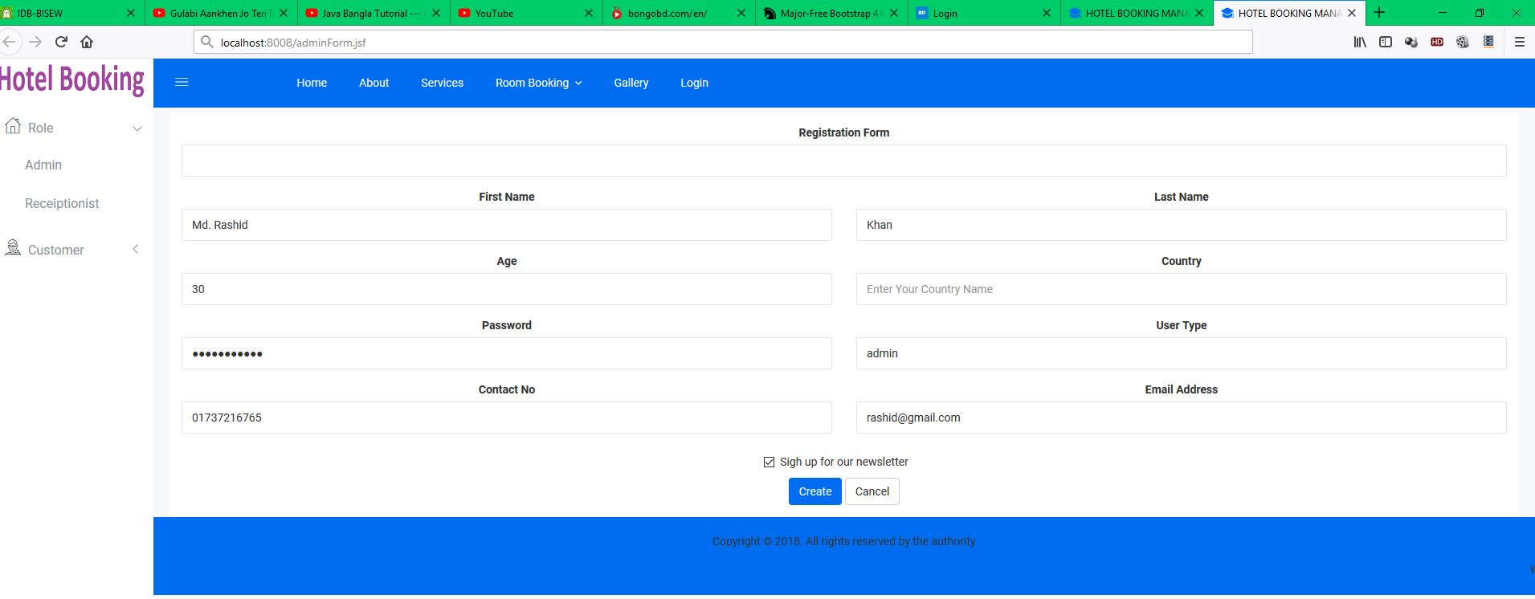
ADMIN FORM

Slide 13
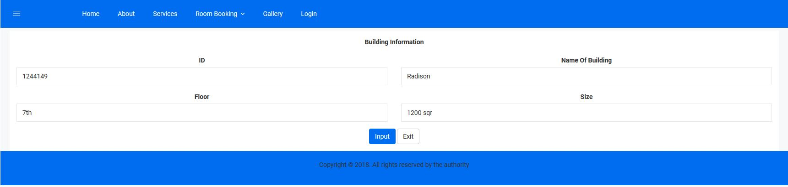
BUILDING TABLE

Slide 14
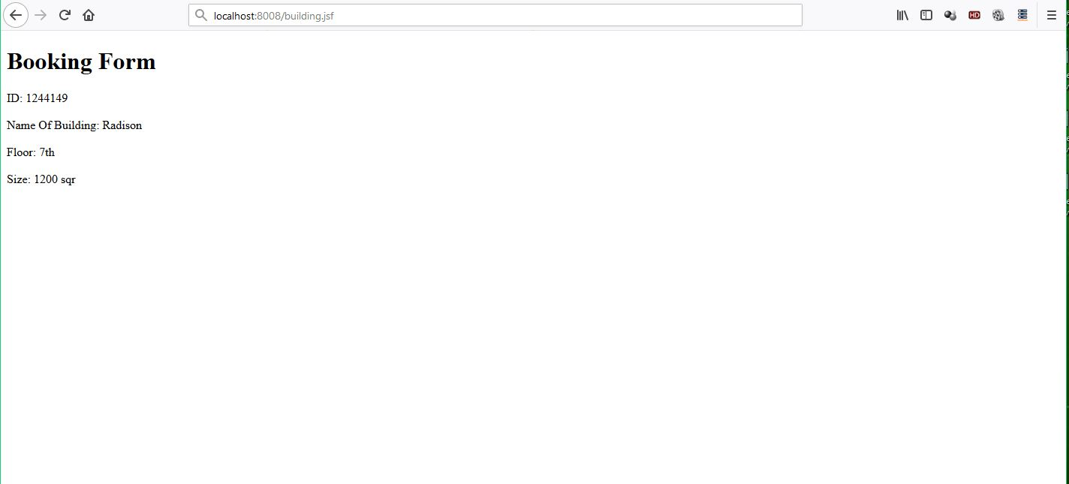
BOOKING FORM

Slide 15
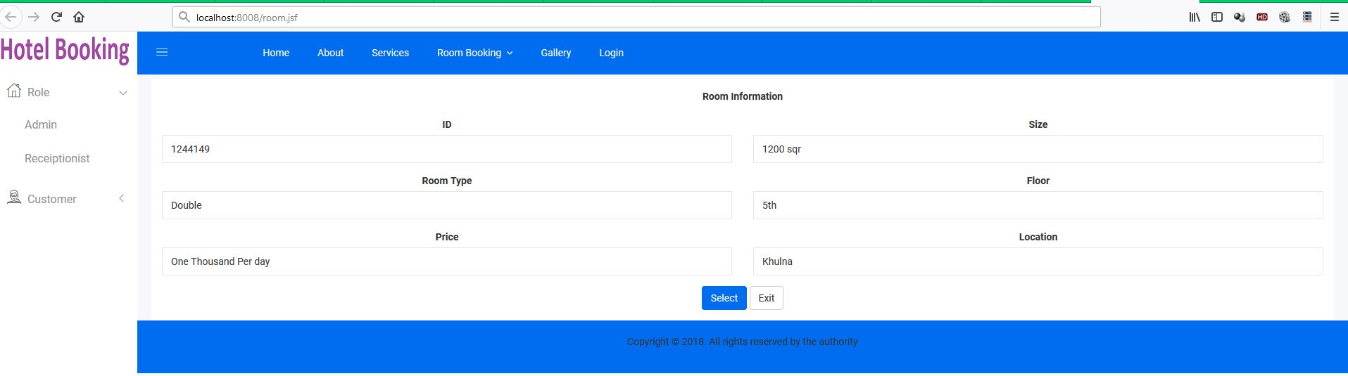
ROOM VIEW

Slide 16
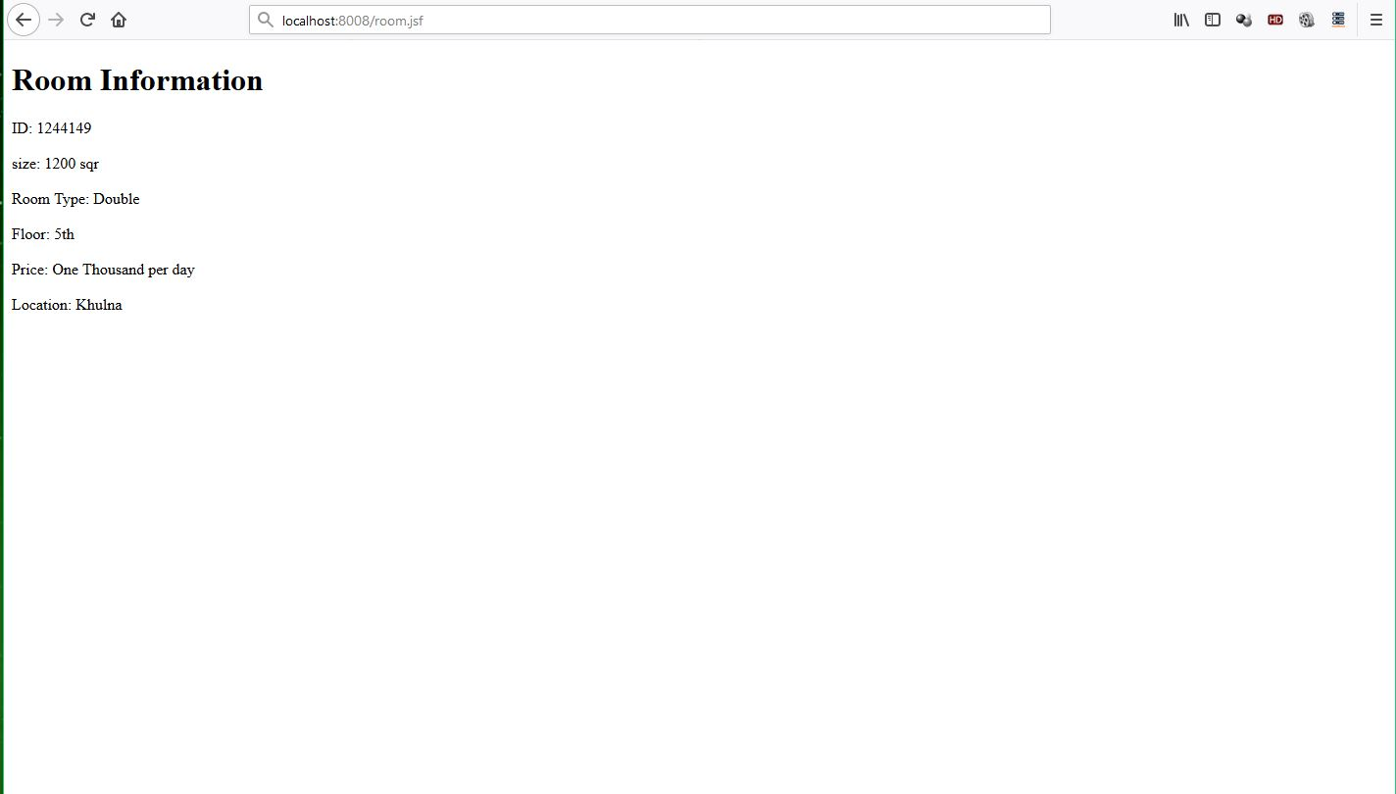
ROOM INFORMATION

Slide 17
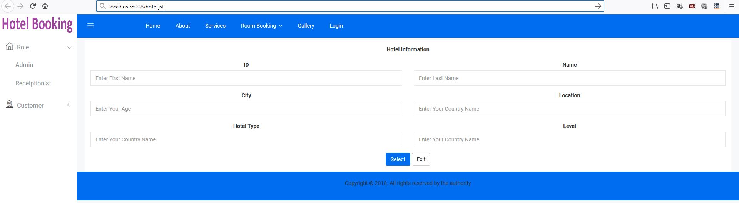
HOTEL VIEW

Slide 18
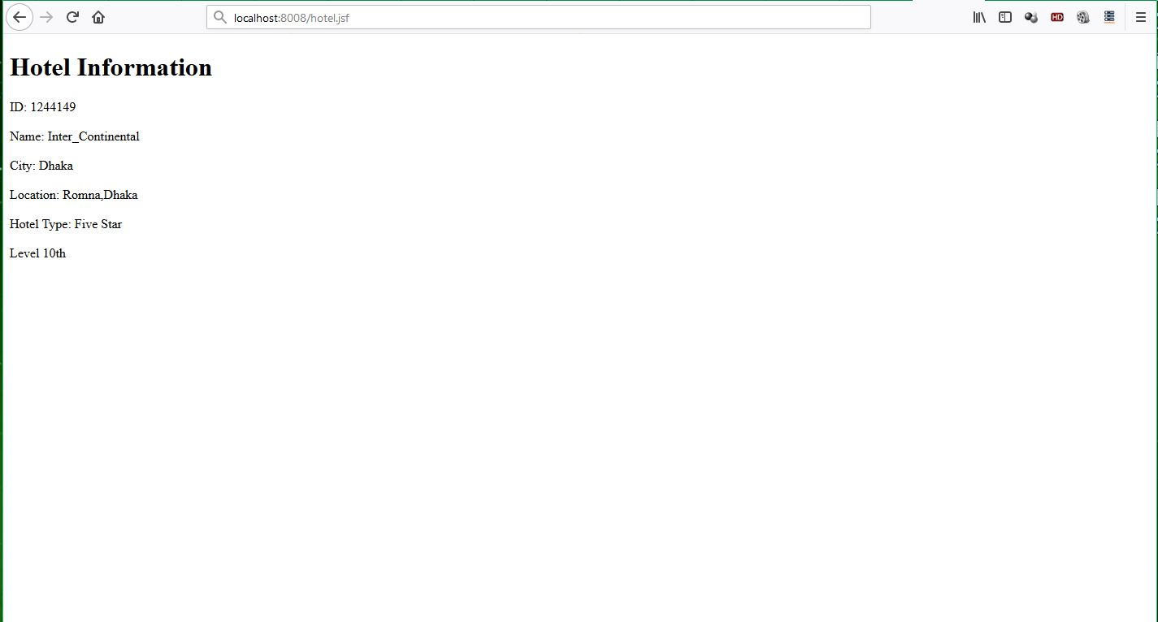
HOTEL INFORMATION

Slide 19
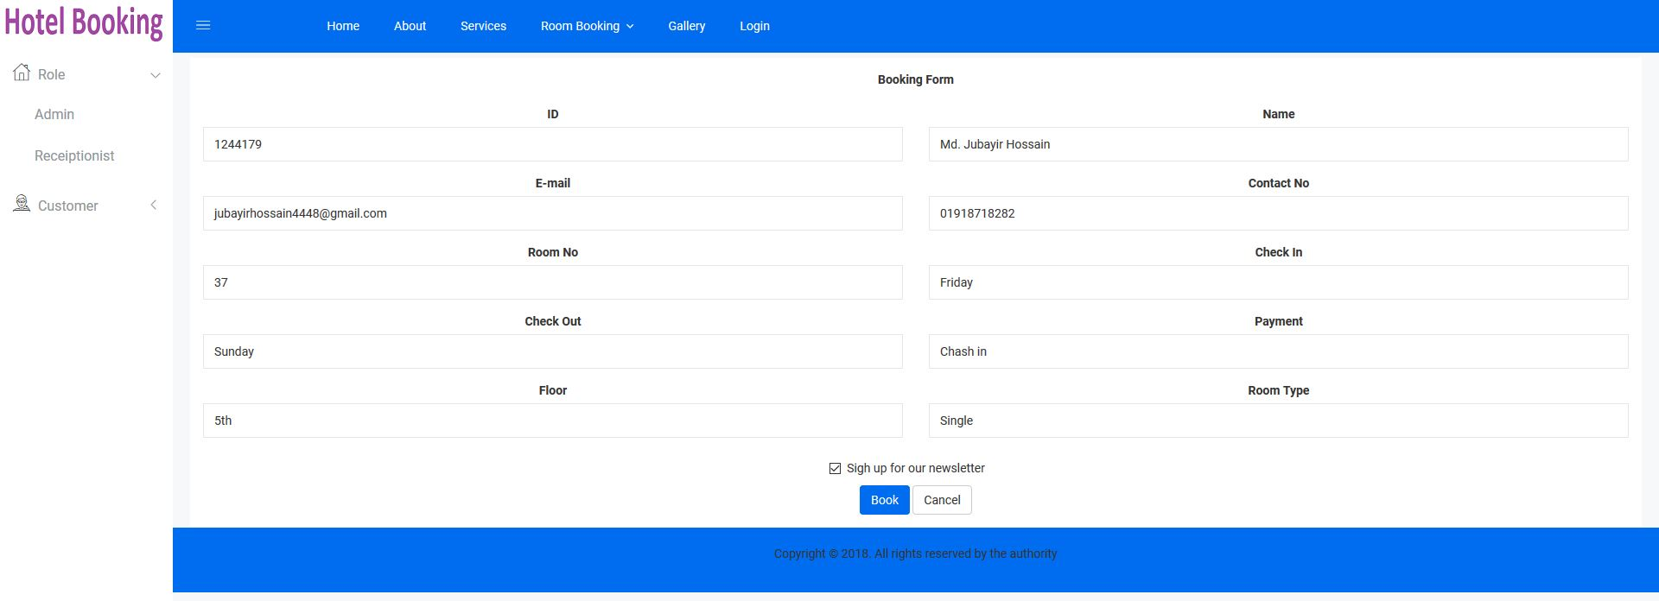
BOOKING VIEW

Slide 20
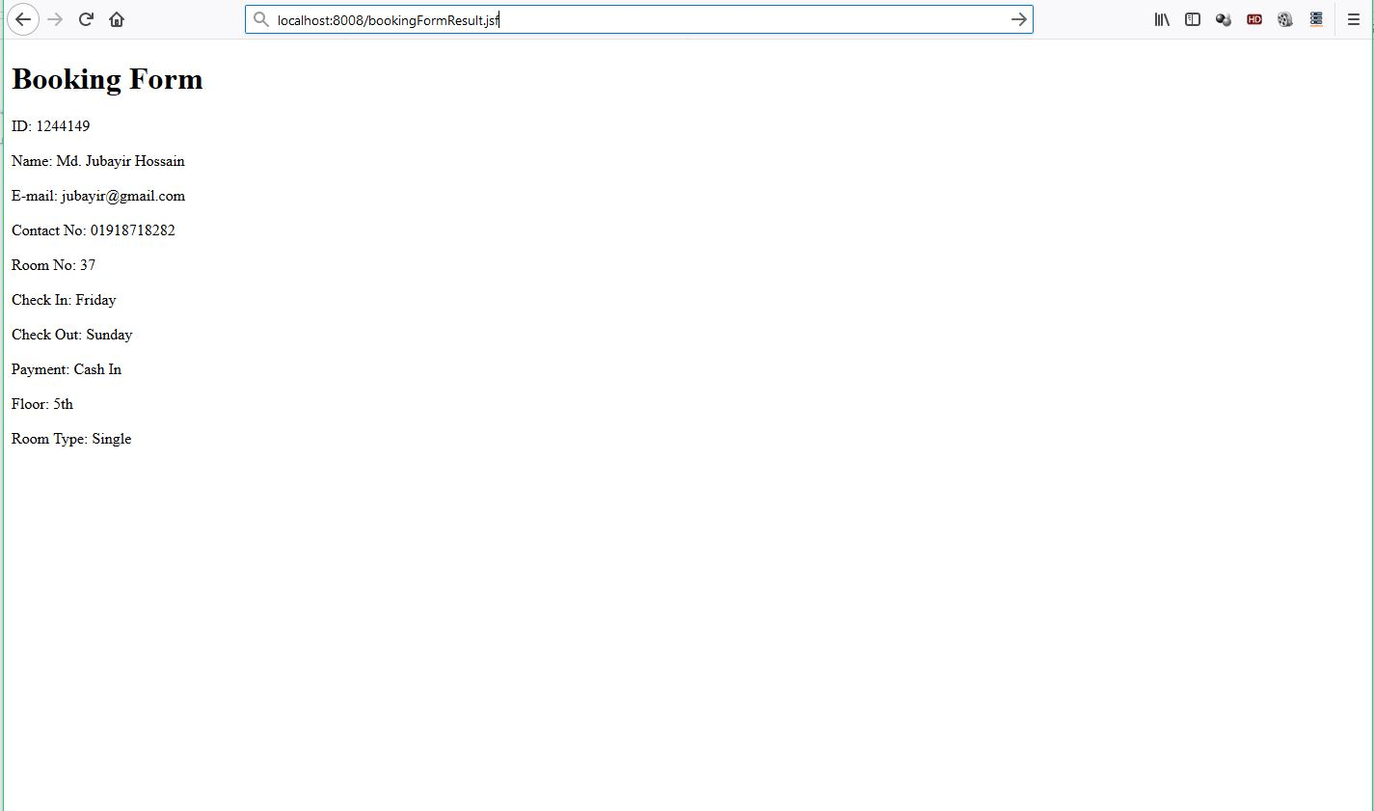
BOOKING FORM

Slide 21

SERVICE INFORMATION

Slide 22
Thank You Sir

